Slide 1
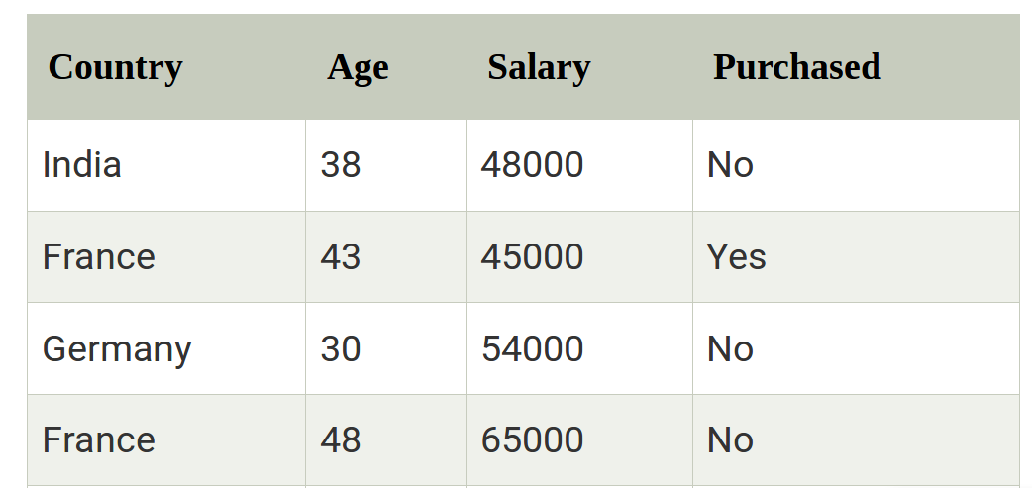
How to get datasets for Machine Learning
A dataset is a collection of data in which data is arranged in some order. A dataset can contain any data from a series of an array to a database table. Below table shows an example of the dataset:

Slide 2
Types of data in dataset
Numerical data:Such as house price, temperature, etc.
Categorical data:Such as Yes/No, True/False, Blue/green, etc.
Ordinal data:These data are similar to categorical data but can be measured on the basis of comparison.
  A 5 point Likert scale
    Very satisfied
    Satisfied
    Indifferent
    Dissatisfied
    Very dissatisfied

Slide 3
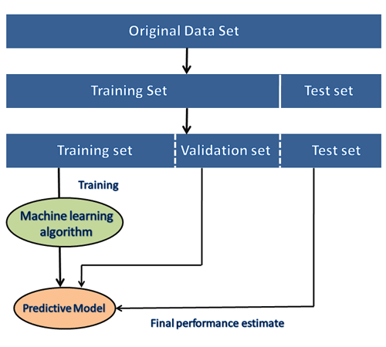
Need of Dataset
ML projects cannot work properly if the dataset is not well prepared and pre-processed.

Slide 4
Popular sources for Machine Learning datasets
Kaggle Datasets
  https://www.kaggle.com/datasets
UCI Machine Learning Repository
Datasets via AWS
Microsoft Datasets
Scikit-learn dataset // https://scikit-learn.org/stable/datasets/index.html
Awesome Public Dataset Collection
Computer Vision Datasets
  https://www.visualdata.io/
Government Datasets
  Indian Government dataset
  US Government Dataset
  Northern Ireland Public Sector Datasets
  European Union Open Data Portal
Google's Dataset Search Engine
  https://toolbox.google.com/datasetsearch

Slide 5
Data Preprocessing in Machine learning
It is a process of preparing the raw data and making it suitable for a machine learning model.
A real-world data contains noises, missing values, and unusable format which cannot be directly used for machine learning models.
It is required tasks for cleaning the data and making it suitable for a machine learning model which also increases the accuracy and efficiency of a machine learning model.

Slide 6
Data preprocessing tasks
Getting the dataset
Importing libraries
Importing datasets
Finding Missing Data
Encoding Categorical Data
Splitting dataset into training and test set
Feature scaling

Slide 7
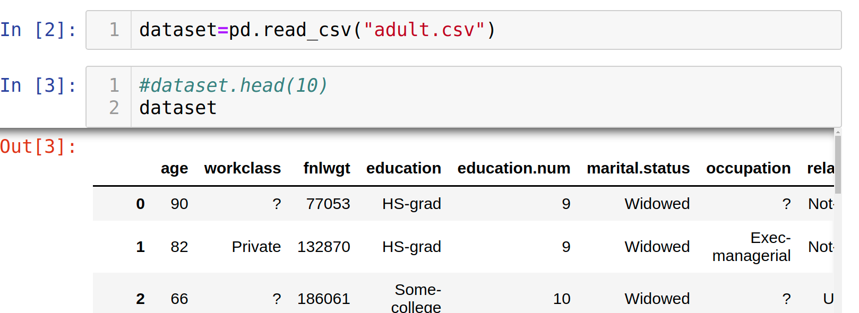
Get the Dataset
The collected data for a particular problem in a proper format is known as the dataset.
CSV stands for "Comma-Separated Values" files; it is a file format which allows us to save the tabular data, such as spreadsheets.

